Slide 1

Capstone Project of (IDTHP) Lab
1 / 10
Title: QuickCraft: Where Ideas Flow, Contents Glow!
Department of Computer Science and Engineering Engineering College Ajmer
Team Mentor
Mr. Deepak Gupta
Team members
Prakriti Singh
Harshita Mandarwal
Chetana Yadav
Manvendra Singh Rathore

Slide 2
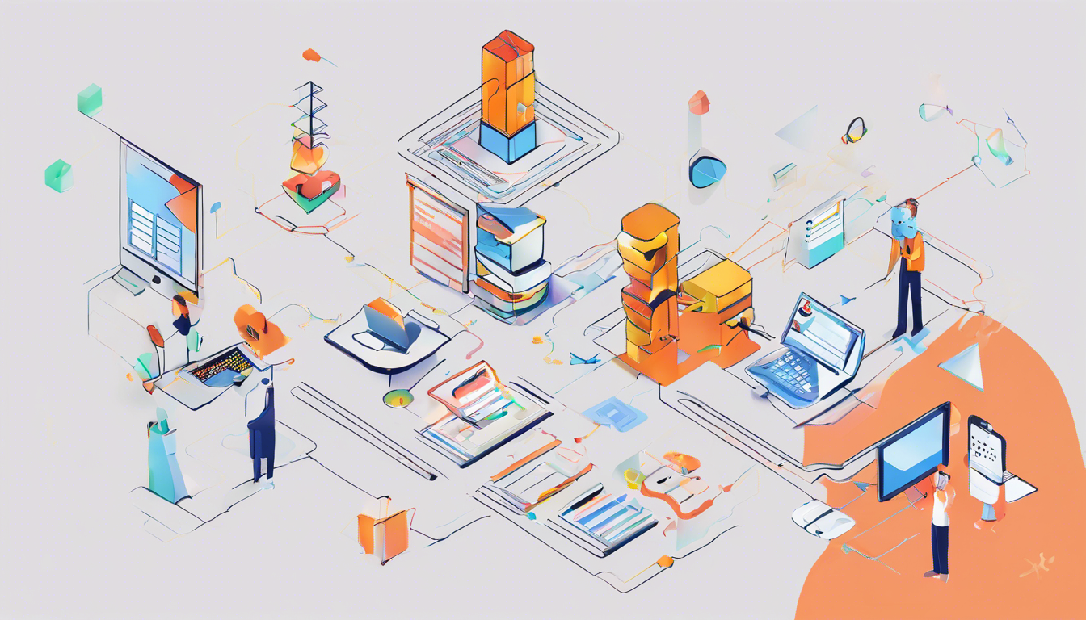
Capstone Project of (IDTHP) Lab
2 / 10
Overview
Welcome to QuickCraft
where creativity meets technology.
Our AI-powered writing platform redefines content creation, offering a seamless blend of innovation and simplicity.
With a user-friendly interface, customizable templates, and an intelligent writing assistant, QuickCraft enables users to effortlessly craft compelling documents, summaries, synopsis, technical documentations ,LinkedIn posts, and more.
Whether you're a professional aiming to elevate your online image or a student seeking writing ease, QuickCraft is the catalyst for turning ideas into impactful content, making your online presence truly shine.

Slide 3
Capstone Project of (IDTHP) Lab
3 / 10
Team
Details of Team Members (VI Sem CYBER SECURITY):
1. Prakriti Singh (Team Leader) 22CYBER39
2. Harshita Mandarwal 22CYBER26
3. Chetana Yadav 22CYBER15
4. Manvendra Singh Rathore 22CYBER32
Team Mentor:
Mr. Deepak Gupta

Slide 4





Capstone Project of (IDTHP) Lab
4 / 10
Business Problem: Why
In the conventional content creation landscape, the manual approach poses challenges of time inefficiency, skill dependency, competitive disadvantage, scalability issues, and the absence of data-driven insights. Professionals and students struggle with time-consuming content creation, limiting productivity. The reliance on advanced writing skills excludes a significant user base.
The lack of AI-driven insights hampers the creation of impactful content, putting individuals at a competitive disadvantage in the digital space. Scalability challenges and the absence of data-driven feedback further hinder the efficiency of traditional methods.
QuickCraft emerges as a modern solution, addressing these challenges with AI-driven features, providing a user-friendly, accessible, and impactful tool for content creation.

Slide 5
Capstone Project of (IDTHP) Lab
5 / 10
Business Problem: What
Business Problem:
Time-Consuming Content Creation: Individuals, both professionals, and students, struggle with the time and effort required to create engaging and relevant content for different purposes.
Lack of Writing Skills: Not everyone possesses the necessary writing skills to produce compelling documents, summaries, or social media posts that make a strong online impact.
Solution with QuickCraft:
AI-Powered Assistance: QuickCraft integrates AI to simplify and expedite the content creation process, offering intelligent guidance to users.
Customizable Templates: The platform provides a variety of templates that users can tailor to their specific needs, catering to diverse content types and formats.
Time Efficiency: With an intuitive interface and AI support, QuickCraft enables users to create high-quality content quickly, saving valuable time.
Enhanced Online Presence: QuickCraft contributes to improving individuals' and businesses' online image by facilitating the creation of impactful content for a competitive edge in the digital landscape.

Slide 6
Capstone Project of (IDTHP) Lab
6 / 10
Idea/Solution/Prototype
Idea: QuickCraft introduces an AI-powered content creation platform that revolutionizes the way individuals approach writing. The core concept revolves around combining user-friendly design with cutting-edge AI to streamline the content creation process.
Solution: QuickCraft solves the prevalent challenge of time-consuming and skill-dependent content creation by offering an intuitive platform. It provides AI-driven assistance, customizable templates, and a seamless user experience, making it accessible for professionals and students alike to generate impactful content effortlessly.
Prototype: The prototype of QuickCraft showcases a super-easy dashboard, versatile templates, and a smart AI writing buddy. Users can input a basic idea or topic, and the platform guides them through creating detailed, relevant content for documents, summaries, LinkedIn posts, and more. The prototype demonstrates the effectiveness of the technology stack, including React.js for the frontend, Node.js for the backend, and key language and AI tools like PyTorch, Hugging Face, LLM, Langchain, and OpenCV. The integration of MongoDB ensures efficient data management. QuickCraft is not just an idea; it's a tangible prototype poised to transform the landscape of content creation.

Slide 7
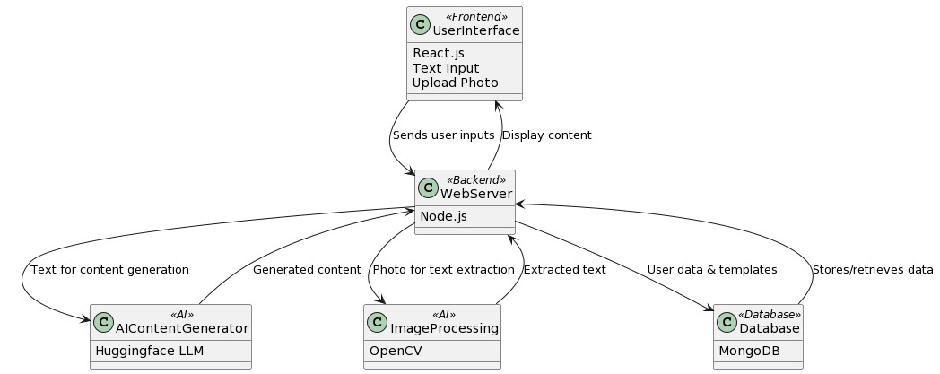
Capstone Project of (IDTHP) Lab
7 / 10
Technology Stack
Frontend:​ Leveraging the robust and dynamic React.js framework to create a seamless and user-friendly interface for QuickCraft.
Backend:​ Utilizing the powerful and scalable Node.js to handle the server-side operations, ensuring efficiency and responsiveness.
Language and AI Tools:
Incorporating cutting-edge technologies such as PyTorch, Hugging Face, LLM, Langchain,
and OpenCV to harness the power of artificial intelligence for smart content creation.
Database:
Employing MongoDB as the database of choice, ensuring efficient data management
and retrieval for a smooth user experience.

Slide 8
Capstone Project of (IDTHP) Lab
8 / 10
Use Cases
LinkedIn Pro Boost:
Use Case: QuickCraft crafts standout LinkedIn posts for professionals.
2. Study Smart:
Use Case: QuickCraft summarizes research papers for efficient understanding.
3. Social Media Simplified:
Use Case: QuickCraft streamlines tailored posts for busy social media managers.
4. Blog Harmony:
Use Case: QuickCraft's Brainy Writing Buddy turns team ideas into a cohesive blog.
5. Polished Content:
Use Case: QuickCraft's "Perfect It" refines content for maximum reader engagement.
6. Event Buzz:
Use Case: QuickCraft turns visual concepts into compelling event descriptions.
7. Speech Recognition Feature:
Use Case: Quickcraft can hear your long paragraphs and incarnate into nice words and formats.

Slide 9
Capstone Project of (IDTHP) Lab
9 / 10
Describe Dependencies
• Hugging Face API: Utilized for integrating advanced natural language processing models,
enhancing QuickCraft's AI capabilities.
• Technology Stack:
Libraries: PyTorch, React.js, Node.js, OpenCV, MongoDB.
Purpose: PyTorch for AI model implementation, React.js and Node.js for frontend
and backend development, OpenCV for image processing, and MongoDB for
efficient data management.
• GPUs for Training: Leveraging GPUs accelerates the training of deep
learning models, ensuring efficient development of QuickCraft's AI features.
• Cloud Services for Deployment: Utilizing AWS, Azure, or Google Cloud for scalable deployment, ensuring optimal performance for QuickCraft.
• Good Internet Connection: A stable and high-speed internet connection is crucial
for accessing external APIs like Hugging Face and ensuring seamless deployment and
continuous updates.
This integrated technology stack forms the foundation of QuickCraft, combining AI capabilities, efficient development tools, scalable deployment options, and reliable internet connectivity.

Slide 10

Capstone Project of (IDTHP) Lab
10 / 10
Economic Logic
Economic Logic for QuickCraft :
User Subscriptions
Transaction Commissions
Premium Upgrades
Advertising Partnerships
Service Provider Subscriptions
Partnerships & Affiliations
Licensing & White Label Solutions
Freemium Model

